Slide 1
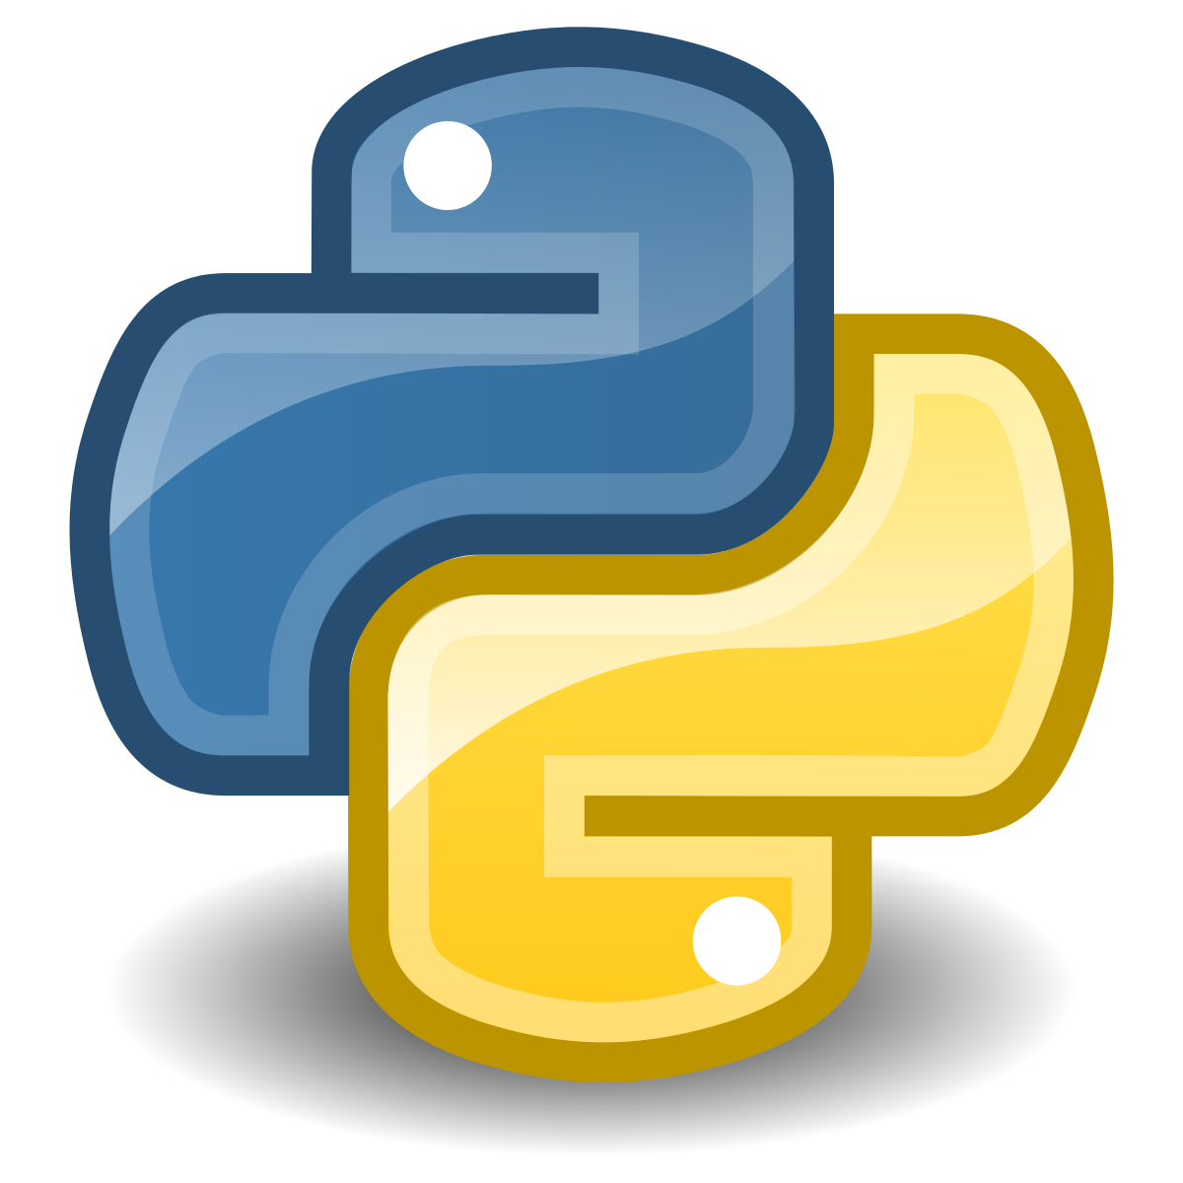
Introduction to programming with Python
Master in Big Data Solutions 2020-2021
Sergio Gago – Guillermo Alonso
sergiogh@gmail.com

Slide 2
Session 3 - Objective
Get used to Linux
Understand Virtual Machines and containers
Build your own development environment and play with it
In the afternoon...
Start coding!

Slide 3
Contents

Slide 4
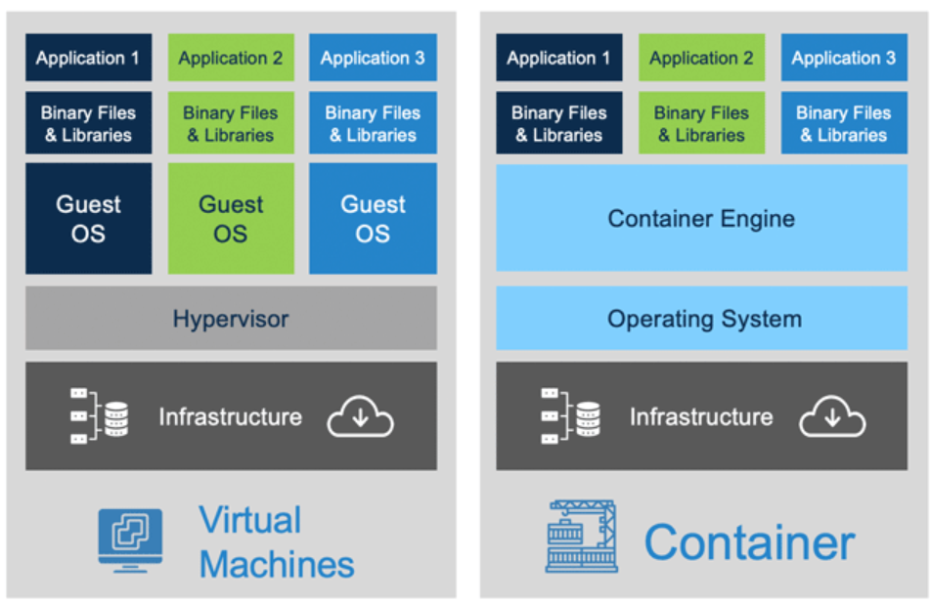

Slide 5
Benefits
It does not matter what your host Operating System is
Fully isolated and fungible
If something is broken, throw it away and rebuild (provided your code is in the repo!)
Sandbox everything. Environments, applications, dependencies.
....
But we are not going to Docker today (but if you feel brave, be my guest! Extra points!)

Slide 6
Installing VirtualBox & Vagrant
Install Vagrant: https://www.vagrantup.com/downloads.html
Install VirtualBox: https://www.virtualbox.org/
Create your working directory for the course $ mkdir python_precourse $ cd python_precourse
$ vagrant box add ubuntu/bionic64 $ vagrant init ubuntu/bionic64
$vagrant up
$ vagrant ssh
Notes:
Mkdir – makes the folder
Cd = changes directory to precourse
Vagrant destroy to start over

Slide 7
The Magic of VirtualBox
In your project folder, create a file test_python.py
Type there print(“Hello World from my VM”) and save the file
$ vagrant ssh
$ cd /vagrant
$ ls
$ python test_python.py

Slide 8
Installing Dependencies
$ sudo apt update
$ sudo apt install python3-pip
$ pip3 search numpy
$ pip3 install numpy
Pip3 is long...
$ nano ~/.bashrc
Add:
alias python=python3
alias pip=pip3
$ source ~/.bashrc
$ pip install conda
$ pip install jupyter
Notes:
Apt = application manager for Linux.
Pip = package manager
Nano = text editor in Ubuntu

Slide 9
Run Notebooks from inside the Virtual Machine
Add to Vagrantfile:
config.vm.network "forwarded_port", guest: 8885, host: 8885, auto_correct: true
$ vagrant reload
$ vagrant up
$ cd /vagrant
$ jupyter notebook --ip=‘0.0.0.0’ --port=8885

Slide 10
VirtualEnv
$ python -m pip install --user virtualenv
What is a virtual environment?
https://virtualenv.pypa.io/en/latest/

Slide 11
Command Line for Beginners
https://ubuntu.com/tutorials/command-line-for-beginners#1-overview

Slide 12
Tools for your Host

Slide 13
Installing Atom
https://atom.io/

Slide 14
Installing Git
https://git-scm.com/downloads
https://desktop.github.com/ (optional)

Slide 15


